Slide 1
1.

Slide 2
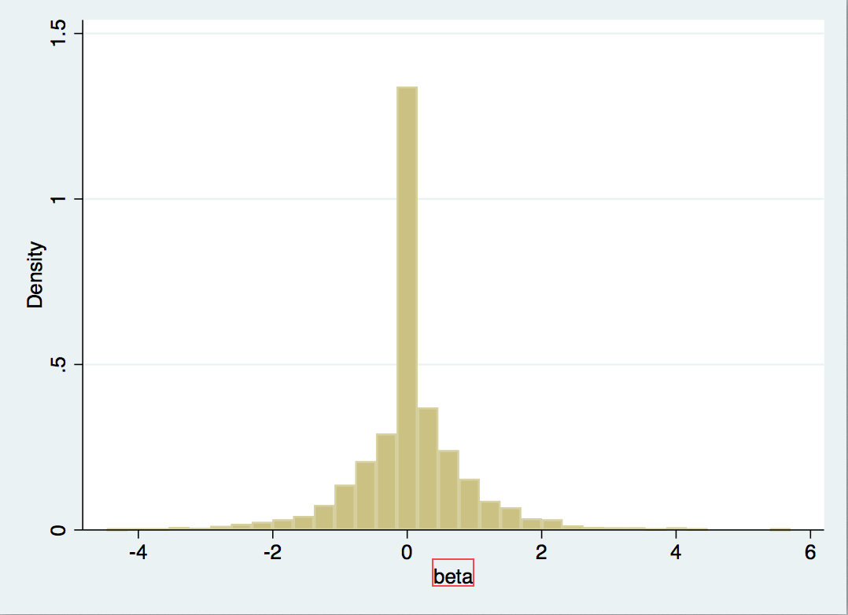
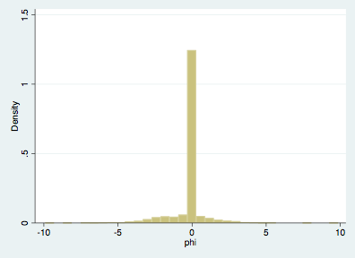
Histogram of beta and phi

Slide 3
Mean of consumption: 91925
Mean of income: 5080494
Mean of beta: 0.0463
Mean of phi: -0.1957

Slide 4
2.
(a)
mean of beta of 5 groups: -0.0092 0.0228 0.1187. 0.0173. 0.0820
median of beta of 5 groups: 0 0 0 0 0
Discussion: a tricky problem is that the median of beta of 5 groups are all 0

Slide 5
(b)
mean of beta of 5 groups: -0.0182 0.0532 0.0197 0.0769. 0.1003
median of beta of 5 groups: 0 0 0 0

Slide 6
(c)
Average assets across groups: 17683523 21440560 15254079 18209660 25498278
Average income across groups: 2926521 3204931 1642206 3259352 2561873

Slide 7
3.

Slide 8
Beta: 0.0316
Phi: -0.7485

Slide 9
4.

Slide 10
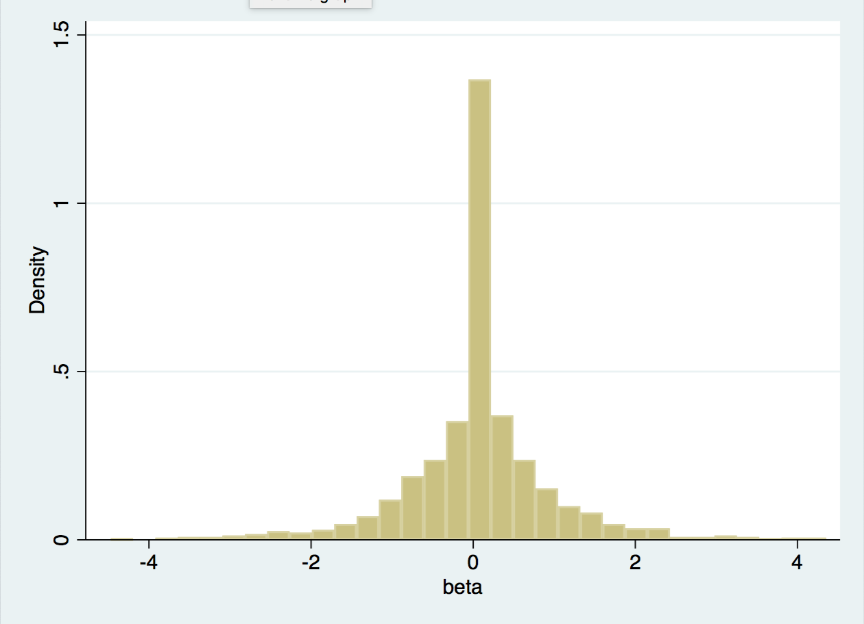
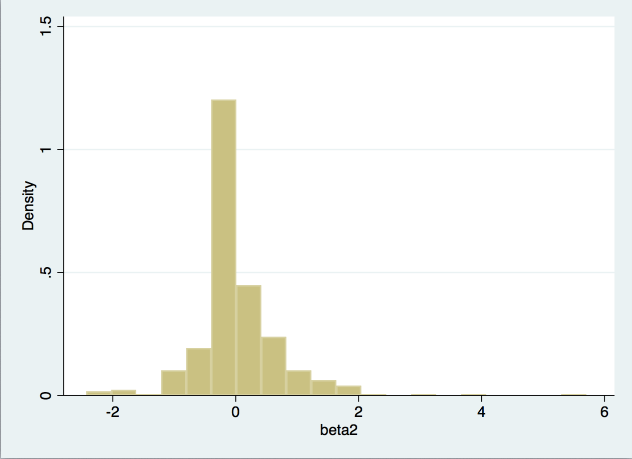
Histogram of beta
rural area. urban area.

Slide 11
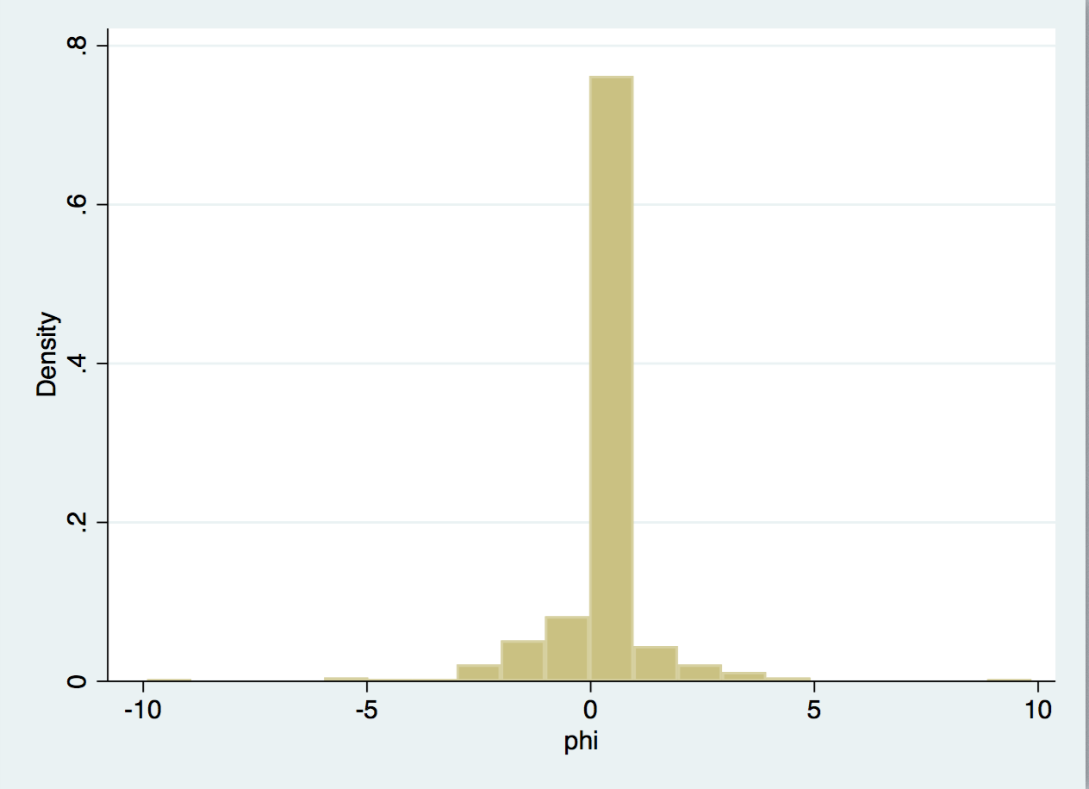
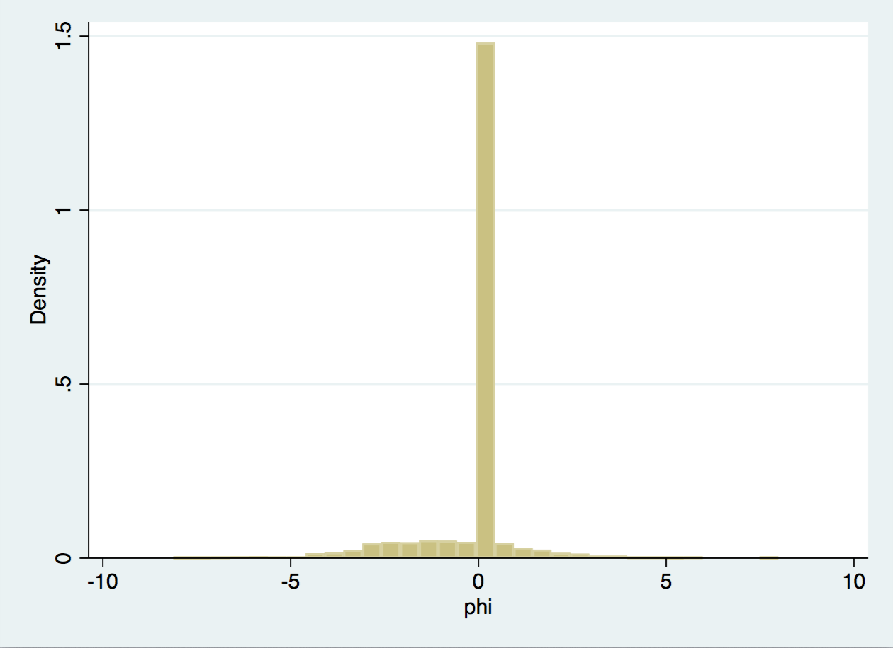
Histogram of beta
urban area rural area

Slide 12
2.rural area
(a)
mean of beta of 5 groups: 0.1196 0.1005. 0.0748. 0.0463. -0.0615
median of beta of 5 groups: 0. 0. 0. 0. 0.
Discussion: a tricky problem is that the mean of 5 groups are all 0

Slide 13
2. urban area
(a)
mean of beta of 5 groups: 0.0264 0.1133. 0.1273. 0.0652. 0.0748
median of beta of 5 groups: 0. 0. 0. 0. 0.
Discussion: a tricky problem is that the mean of 5 groups are all 0

Slide 14
rural area
(b)
mean of beta of 5 groups:
median of beta of 5 groups: 0. 0. 0. 0. 0.
Discussion: a tricky problem is that the mean of 5 groups are all 0

Slide 15
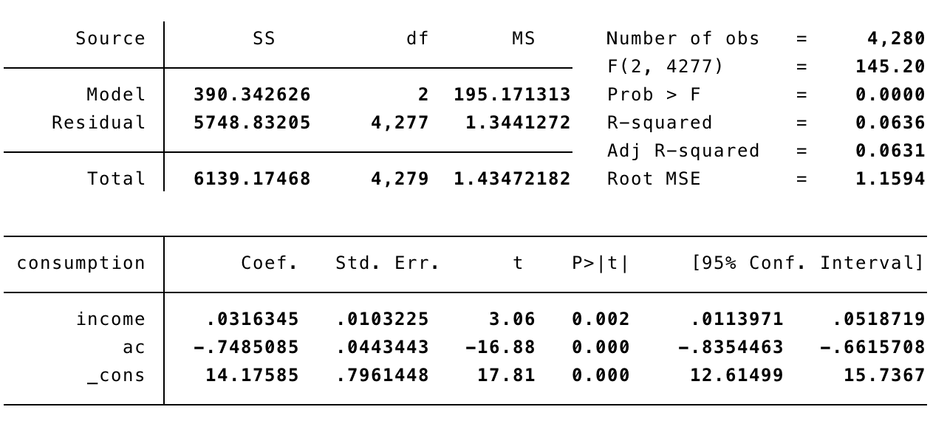
Appendix
Regression of (1)

